Slide 1
Māori Data Sovereignty and Digital Colonisation
Digital Justice - Emerging Technologies, Methods and Research
Karaitiana Taiuru. Ngāi Tahu; Ngāti Rārua; Ngāti Kahungunu.
@ktaiuru
Email: Karaitiana@taiuru.maori.nz

Slide 2
Treaty of Waitangi protects Māori Data
Article II English:
Her Majesty the Queen of England confirms and guarantees to the Chiefs and Tribes of New Zealand and to the respective families and individuals thereof the full exclusive and undisturbed possession of their Lands and Estates Forests Fisheries and other properties which they may collectively or individually possess so long as it is their wish and desire to retain the same in their possession; but the Chiefs of the United Tribes and the individual Chiefs yield to Her Majesty the exclusive right of Preemption over such lands as the proprietors thereof may be disposed to alienate at such prices as may be agreed upon between the respective Proprietors and persons appointed by Her Majesty to treat with them in that behalf.

Slide 3
Te Tiriti protects Māori Data
Article II Translation:
The Queen of England agrees to protect the chiefs, the subtribes and all the people of New Zealand in the unqualified exercise of their chieftainship over their lands, villages and all their treasures. But on the other hand the Chiefs of the Confederation and all the Chiefs will sell land to the Queen at a price agreed to by the person owning it and by the person buying it (the latter being) appointed by the Queen as her purchase agent.

Slide 4
Article II relevance to Māori Data
Partnership: interactions between the Treaty partners must be based on mutual good faith, cooperation, tolerance, honesty and respect
Participation: this principle secures active and equitable participation by tangata whenua
Protection: government must protect whakapapa, cultural practices and taonga, including protocols, customs and language.

Slide 5
United Nations Declaration on the Rights of Indigenous Peoples 2007.
Its 46 articles cover all areas of human rights and interests as they apply to Indigenous Peoples. The following 21 articles are generally applicable to Indigenous Data. Depending on the Data there may be others.
Articles: 1,2,3,4,7,8,11,15,18,19,32,37,38,39,40,41,42,43,44,45,46

Slide 6
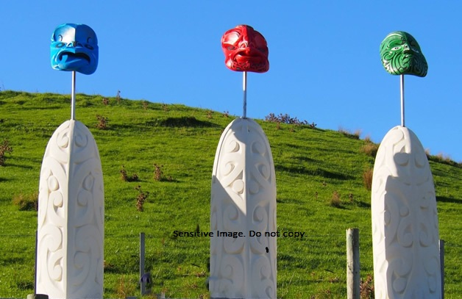
Pre Colonisation, Maori perceptions of Data

Slide 7
What is Māori Data
Information or knowledge, in any format or medium, which is about, from, produced by Māori, describes Māori and the environments Maori have relationships with, made by Māori or contains any Māori content or association or may affect Māori, whānau, hapū, iwi and Māori organisations either collectively or individually.

Slide 8
Māori Data Sovereignty – Common Definition in New Zealand
Māori Data Sovereignty supports tribal sovereignty and the revitalisation of Maori and Iwi aspirations. (Te Mana Rauranga Maori Data Sovereignty Network)

Slide 9
Māori Data Sovereignty – a modified definition.
Māori Data Sovereignty refers to the inherent rights and interests Māori, whānau, hapū, iwi and Māori organisations have in relation to the creation, collection, access, analysis, interpretation, management, dissemination, re-use and control of data relating to Māori, whānau, hapū, iwi and Māori organisations as guaranteed in Article II of Te Tiriti/Treaty of Waitangi.

Slide 10
Māori Data Sovereignty – some practicable steps
Co-Govern, Co-Design and Co-Innovate with Māori
Treaty of Waitangi/Te Tiriti and Māori Ethics Guidelines for: AI, Algorithms, Data and IOT (Taiuru,K. 2020)
Host Data on shore.
Be familiar with Digital Colonisation
Māori Frameworks
Tikanga Test (Mead, S. M. (2016. Revis ed.)
Te Whare Tapa Whā (Durie, M. 1984)
Māori Data Sovereignty Guidelines (Te Mana Raraunga, 2018)
Crown engagement with Māori Framework and Engagement Guidelines (Te Arawhiti 2019)
Māori Data Ethical Framework (Taiuru, K. 2020).

Slide 11
Digital Colonisation
Digital colonialism deals with the ethics of digitizing Indigenous data and information without fully informed consent.
Digital colonialism is the new deployment of a quasi-imperial power over a vast number of people, without their explicit consent, manifested in rules, designs, languages, cultures and belief systems by a vastly dominant power (Renata Avila, 2017).
A new form of imperialism by technology conglomerates for commercial gains; academics and researchers to advance science, technology and research (Taiuru 2017).
Data colonialism is an emerging order for the appropriation of human life so that data can be continuously extracted from it for profit (Ulises A. Mejiasand Nick Couldry. 2019).

Slide 12
Māori Data Governance
Is the right of Māori, whānau, hapū, iwi and Māori organisations to autonomously decide what, how and why Māori data are collected, stored, accessed and used.
It ensures that Māori data reflects Te Tiriti/Treaty Principles.

Slide 13
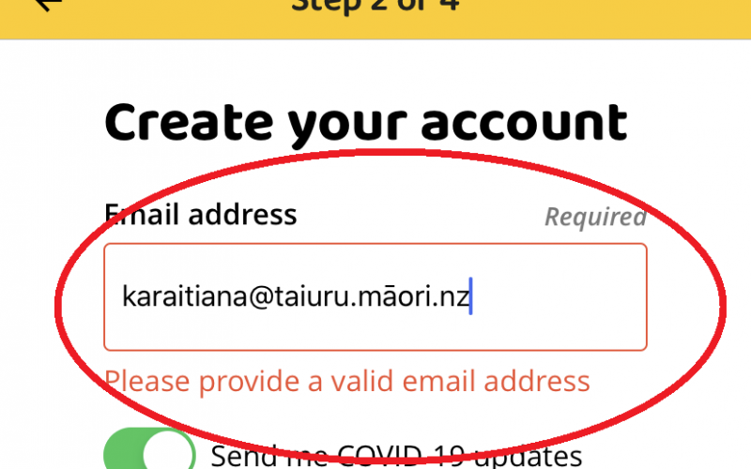
Govt Covid19 Tracing App

Slide 14
Budapest Convention
Data is a Taonga
Communal usage of community computers
Shared Household usage of mobile devices which may be school property.
A Māori Data Governance group/expert advisory process is required.

Slide 15
Extra reading by the author 1 of 2
Māori Data Sovereignty Rights for Well Being (September 25, 2019) https://www.taiuru.maori.nz/maori-data-sovereignty-rights-for-well-being/
Māori cultural and ethical considerations in Information Security https://www.taiuru.maori.nz/wp-content/uploads/OWASP-2020.pdf
Māori ethics associated with AI systems architecture (October 17 2019) https://www.taiuru.maori.nz/maori-ethical-considerations-with-artificial-intelligence-system/
Māori ethics associated with AI systems architecture (September 14, 2019) https://www.taiuru.maori.nz/maori-ethics-associated-with-ai-systems-architecture/
Māori Data Sovereignty Rights for Well Being (September 25 2019) https://www.taiuru.maori.nz/maori-data-sovereignty-rights-for-well-being/
Submission on Government algorithm transparency and accountability https://www.taiuru.maori.nz/submission-on-government-algorithm-transparency-and-accountability/
Treaty Clause Required for NZ Government AI Systems and Algorithms https://www.taiuru.maori.nz/treaty-clause-required-nz-government-ai-systems-and-algorithms/

Slide 16
Extra reading by the author 2 of 2
Indigenising knowledge of Telecommunications and Smart Phones (July 23, 2019 https://www.taiuru.maori.nz/huia/
Māori cultural considerations with Artificial Intelligence and Robotics (June 21, 2019) https://www.taiuru.maori.nz/ai-robotics-maori-cultural-considerations/
Why Data is a Taonga: A customary Māori perspective. (November 2018) http://taiuru.maori.nz/data-is-a-taonga
Definition: Digital Colonialism (July 23, 2015) https://www.taiuru.maori.nz/definition-digital-colonialism/

Slide 17
References
Durie, M. (1984). Te Whare Tapa Whā
Mead, S. M. (2016). Tikanga Māori: living by Māori values (Revis ed.). Wellington: Huia Publishers.
Mejias, Te Mana Raraunga (October 2018). Principles of Maori Data Sovereignty. New Zealand.
Taiuru, K. (2015). Definition: Digital Colonialism Retrieved from https://www.taiuru.maori.nz/definition-digital-colonialism/
Taiuru, K. (2018). Data is a Taonga. A customary Māori perspective. Retrieved from https://www.taiuru.maori.nz/data-is-a-taonga/
Taiuru,K (2020. Treaty of Waitangi/Te Tiriti and Māori Ethics Guidelines for: AI, Algorithms, Data and IOT https://www.taiuru.maori.nz/tiritiethicalguide/
Taiuru,K (2020. Māori Data Ethical Framework https://www.taiuru.maori.nz/tiritiethicalguide/maori-data-ethical-framework/
Te Mana Raraunga (October 2018). Principles of Maori Data Sovereignty. New Zealand.
Ulises A. Mejias & Nick Couldry (2019). [BigDataSur] Some thoughts on decolonizing data.

